Slide 1
Chapter 10
SQL Data Manipulation Language (DML) and
Transaction Control

Slide 2
SQL Overview
SELECT
INSERT
UPDATE
DELETE
MERGE
CREATE
ALTER
DROP
RENAME
TRUNCATE
COMMENT
GRANT
REVOKE
COMMIT
ROLLBACK
SAVEPOINT
Data manipulation language (DML)
Data definition language (DDL)
Data control language (DCL)
Transaction control
Notes:
Oracle Database 11g: SQL Fundamentals I I - <number>
DON’T BE FOOLED BY THE SIMPLE-LOOKING STATEMENTS!!
In practice, SQL coding can be very easy, but it also can be very complicated.

Slide 3
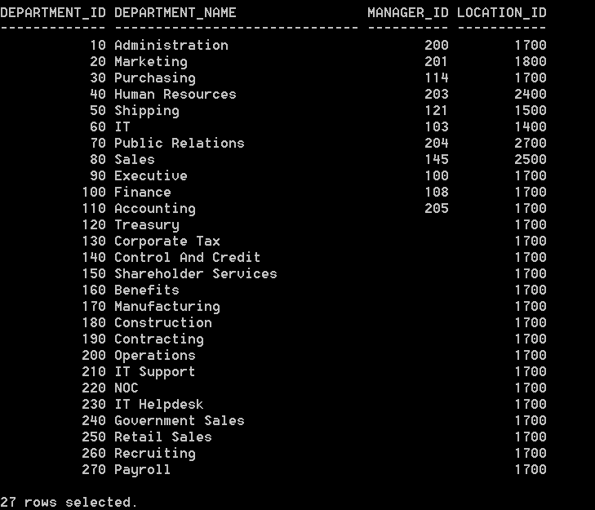
View the departments table:
SELECT * FROM departments;
We need to create a sequence to
keep track of the department numbers

Slide 4
Sequences
Auto numbers for surrogate primary key values
General Syntax:
CREATE SEQUENCE sequence
[INCREMENT BY n]
[START WITH n]
[{MAXVALUE n | NOMAXVALUE}]
[{MINVALUE n | NOMINVALUE}]
[{CYCLE | NOCYCLE}]
[{CACHE n | NOCACHE}];

Slide 5
Now create the sequence:
CREATE SEQUENCE departments_dept_id_seq
INCREMENT BY 10
START WITH 280;

Slide 6
If the START WITH clause is omitted, the sequence starts with 1

Slide 7
NEXTVAL and CURRVAL
  NEXTVAL returns the next available sequence value. It returns a unique value every time it is referenced, even for different users.
  CURRVAL obtains the current sequence value.
  NEXTVAL must be issued for that sequence before CURRVAL contains a value.

Slide 8
SQL Data Manipulation Language (DML)
INSERT
UPDATE
DELETE

Slide 9
INSERT statement
INSERT INTO table [(column, [, column…]) ]
VALUES (value, [, value…]);
Only one row is inserted at a time
Example:
INSERT INTO departments (department_id, department_name, manager_id, location_id)
VALUES (departments_dept_id_seq.NEXTVAL,
‘Development’, 121, 3200);

Slide 10
Another example (with some values omitted):
INSERT INTO departments (department_id, department_name)
VALUES
(departments_dept_id_seq.NEXTVAL, ‘MIS’);
Manager_id and location_id are omitted, so they are given a NULL value

Slide 11
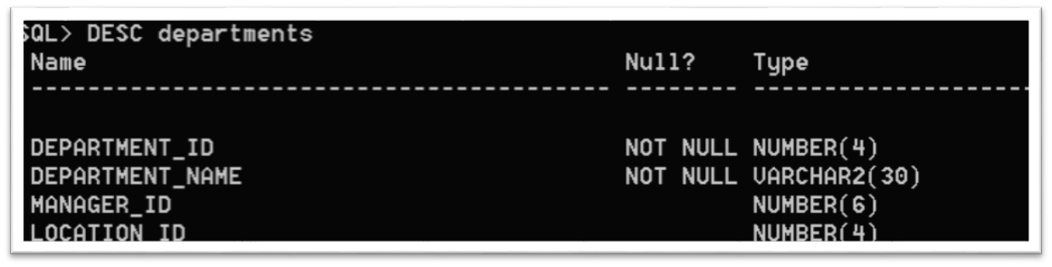
Column names are optional:
INSERT INTO departments
VALUES (departments_dept_id_seq.NEXTVAL, ‘Research’, 101, 1000);
List values in default order of the table:

Slide 12
Create a table called MANAGER:
CREATE TABLE manager
(mgr_id NUMBER(4),
mgr_name VARCHAR2(20),
salary NUMBER(7,2),
CONSTRAINT manager_mgr_id_PK PRIMARY KEY(mgr_id));
Table created.

Slide 13
Copying multiple rows from another table:
INSERT INTO manager
  SELECT employee_id, last_name, salary
  FROM employees
  WHERE job_id LIKE ‘%MGR%’
  OR job_id LIKE ‘%MAN%’;
  14 rows created.
  Commit;
Do not use the VALUES clause when using the SELECT. Match up the number & type of columns
Columns need not have the same names

Slide 14
UPDATE statement
UPDATE table
SET column = value [, column = value, …]
[WHERE condition];
This can update one or more columns (and/or rows) at a time

Slide 15
Example:
UPDATE manager
SET salary = 9000
WHERE mgr_id = 145;
SQL> commit;
This commits ALL
Uncommitted INSERTS,
UPDATES, or DELTES
Back to the last commit

Slide 16
Consider this example:
UPDATE employees
SET department_id = 500
WHERE employee_id = 205;
ERROR at line 1:
ORA-02291: integrity constraint (POLLACIA.EMP_department_id) violated - parent key not found
(there is no employee with ID 205)

Slide 17
DELETE statement
DELETE [FROM] table
[WHERE condition];
This can delete one or more rows from a table

Slide 18
Example deleting one record:
DELETE FROM departments
WHERE department_id = 270;
1 row deleted.

Slide 19
Integrity constraint error:
DELETE from departments
WHERE department_id = 10;
DELETE from departments
*
ERROR at line 1:
ORA-02292: integrity constraint
(POLLACIA.EMP_FOREIGN_KEY) violated –
child record found
(there are some employees assigned
to department 10, so we can’t
delete it.)

Slide 20
Be careful with Delete
If the table was created with Foreign Key ON DELETE CASCADE option
When you delete the parent row, any associated child rows are also deleted!
That means if you deleted department 10, then all employees assigned to department 10 would also be deleted from the employees table

Slide 21
Transaction control
Transaction is a collection of DML statements that form a logical unit.
  Ex: transfer money from a savings account to a checking account
  “ALL OR NOTHING” – all DML statements must be performed without error or NONE of them performed

Slide 22
Transaction control: Commit and rollback
Changes made to the database using DML statements are not permanent until:
COMMIT statement is issued
Or the user exits the SQL session
Or a DDL command is issued
  DDL commands have an implicit commit

Slide 23
Example:
UPDATE employees
SET department_id = 10
WHERE employee_id = 204;
1 row updated.
COMMIT;
Commit complete.
Update is made
permanent

Slide 24
ROLLBACK
Undo any pending changes to the database
DELETE from departments;
6 rows deleted.
ROLLBACK;
Rollback complete.
DELETE from departments
WHERE department_id = 60;
1 row deleted.

Slide 25
SAVEPOINT
A bookmark that designates the beginning of a section of a transaction
You can rollback to a particular savepoint
Normally a rollback will undo all DML statements up to the last COMMIT

Slide 26
Try the following SQL statements to illustrate the use of SAVEPOINT:
INSERT INTO manager VALUES
(4455, ‘CINDERELLA’, 5000);
SELECT * FROM manager;
SAVEPOINT Save1;
INSERT INTO manager VALUES
(4456, ‘SNOW WHITE’, 6000);
SELECT * FROM manager;
ROLLBACK TO Save1;
SELECT * FROM manager;

Slide 27
TRUNCATE (DDL statement)
TRUNCATE TABLE manager;
Deletes all rows from a table
The table definition still exists
Automatically issues a COMMIT
  You cannot Rollback this command

